Slide 1
Introduction to Emerging Technologies (CoSc1012)
Hawassa University
Compiled By Faculty of Informatics Course Coordinators
February 2020

Slide 2
Chapter 1: Introduction to Emerging Technologies

Slide 3
Chapter Outline
Evolution of Technologies
Introduction to the Industrial Revolution (IR)
The Most Important Inventions of the Industrial Revolution
Historical Background (IR 1.0, IR 2.0, IR 3.0)
Role of Data for Emerging Technologies
Enabling devices and network (Programmable devices)
List of some Programmable devices
Human to Machine Interaction
Disciplines Contributing to Human-Computer Interaction (HCI)
Future Trends in Emerging Technologies
Emerging technology trends in 2019
Some emerging technologies that will shape the future of you and your business

Slide 4
Evolution of Technologies
Emerging technology is a term generally used to describe a new technology, but it may also refer to the continuing development of existing technology;
It can have slightly different meanings when used in different areas, such as media, business, science, or education.
The term commonly refers to technologies that are currently developing, or that are expected to be available within the next five to ten years, and is usually reserved for technologies that are creating or are expected to create significant social or economic effects.
Technological evolution is a theory of radical transformation of society through technological development.

Slide 5
Evolution of Technologies(cont..)
What is the root word of technology and evolution?
Technology: 1610s, “discourse or treatise on an art or the arts," from Greek tekhnologia” systematic treatment of an art, craft, or technique," originally referring to grammar, from tekhno- (see techno-) + -logy.
Evolution: evolution means the process of developing by gradual changes.

Slide 6
Evolution of Technologies(cont..)
List of some currently available emerged technologies
Artificial Intelligence
Blockchain
Augmented Reality and Virtual Reality
Cloud Computing
Angular and React
DevOps
Internet of Things (IoT)
Intelligent Apps (I-Apps)
Big Data
Robotic Processor Automation (RPA)

Slide 7
Introduction to the Industrial Revolution (IR)
The Industrial Revolution was a period of major industrialization and innovation that took place during the late 1700s and early 1800s.
An Industrial Revolution at its core occurs when a society shifts from using tools to make products to use new sources of energy, such as coal, to power machines in factories.
The revolution started in England, with a series of innovations to make labor more efficient and productive.
The Industrial Revolution was a time when the manufacturing of goods moved from small shops and homes to large factories.
This shift brought about changes in culture as people moved from rural areas to big cities in order to work.

Slide 8
Introduction to the Industrial Revolution (IR)
The American Industrial Revolution commonly referred to as the Second Industrial Revolution, started sometime between 1820 and 1870.
The impact of changing the way items was manufactured had a wide reach.
Industries such as textile manufacturing, mining, glass making, and agriculture all had undergone changes.
From the first industrial revolution (mechanization through water and steam power) to the mass production and assembly lines using electricity in the second, the fourth industrial revolution will take what was started in the third with the adoption of computers and automation and enhance it with smart and autonomous systems fueled by data and machine learning.
Generally, the following industrial revolutions fundamentally changed and transferred the world around us into modern society.
The steam engine,
The age of science and mass production, and
The rise of digital technology
Smart and autonomous systems fueled by data and machine learning.

Slide 9
The Most Important Inventions of the Industrial Revolution
Transportation: The Steam Engine, The Railroad, The Diesel Engine, The Airplane.
Communication: The Telegraph. The Transatlantic Cable. The Phonograph. The Telephone.
Industry: The Cotton Gin. The Sewing Machine. Electric Lights.

Slide 10
Historical Background of IR
The industrial revolution began in Great Britain in the late 1770s before spreading to the rest of Europe.
The first European countries to be industrialized after England were Belgium, France, and the German states.
The final cause of the Industrial Revolution was the effects created by the Agricultural Revolution.
As previously stated, the Industrial Revolution began in Britain in the 18th century due in part to an increase in food production, which was the key outcome of the Agricultural Revolution.
The four types of industries are:
The primary industry involves getting raw materials e.g. mining, farming, and fishing.
The secondary industry involves manufacturing e.g. making cars and steel.
Tertiary industries provide a service e.g. teaching and nursing.
The quaternary industry involves research and development industries e.g. IT.

Slide 11
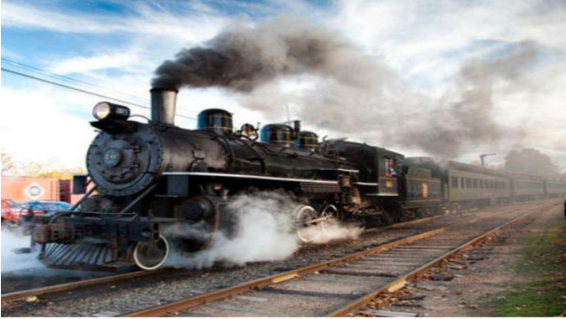
Industrial Revolution (IR 1.0)
The Industrial Revolution (IR) is described as a transition to new manufacturing processes.
IR was first coined in the 1760s, during the time where this revolution began.
The transitions in the first IR(IR 1.0) included
going from hand production methods to machines,
the increasing use of steam power (see Figure below),
the development of machine tools and the rise of the factory system.

Slide 12
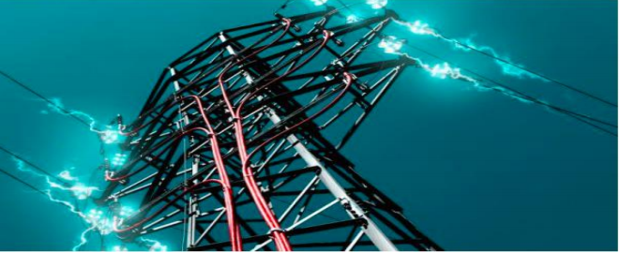
Industrial Revolution (IR 2.0)
IR 2.0, also known as the Technological Revolution, began somewhere in the 1870s.
The advancements in IR 2.0 included
the development of methods for manufacturing interchangeable parts and
widespread adoption of pre-existing technological systems such as telegraph and railroad networks. This adoption allowed the vast movement of people and ideas, enhancing communication.
Moreover, new technological systems were introduced, such as electrical power (see Figure below) and telephones.

Slide 13
Industrial Revolution (IR 3.0)
IR 3.0 introduced the transition from mechanical and analog electronic technology to digital electronics (see Figure on the next slide) which began from the late 1950s.
Due to the shift towards digitalization, IR 3.0 was given the nickname, “Digital Revolution”.
The core factor of this revolution is the mass production and widespread use of digital logic circuits and its derived technologies such as the computer, handphones and the Internet.
These technological innovations have arguably transformed traditional production and business techniques enabling people to communicate with another without the need of being physically present.
Certain practices that were enabled during IR 3.0 is still being practiced until this current day, for example – the proliferation of digital computers and digital record.

Slide 14
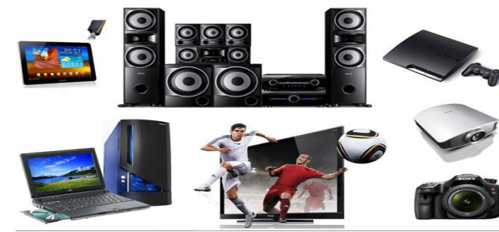
Industrial Revolution (IR 3.0)

Slide 15
Industrial Revolution (IR 4.0)
Now, with advancements in various technologies such as robotics, Internet of Things, additive manufacturing and autonomous vehicles, IR 4.0 was coined by Klaus Schwab, in the year 2016.
The technologies mentioned above are what you call – cyber-physical systems.
A cyber-physical system is a mechanism that is controlled or monitored by computer-based algorithms, tightly integrated with the Internet and its users.

Slide 16
Industrial Revolution (IR 4.0)
One example that is being widely practiced in industries today is the usage of Computer Numerical Control (CNC) machines.
These machines are operated by giving it instructions using a computer.
Another major breakthrough that is associated with IR 4.0 is the adoption of Artificial Intelligence (AI),
AI is also one of the main elements that give life to Autonomous Vehicles and Automated Robots.

Slide 17
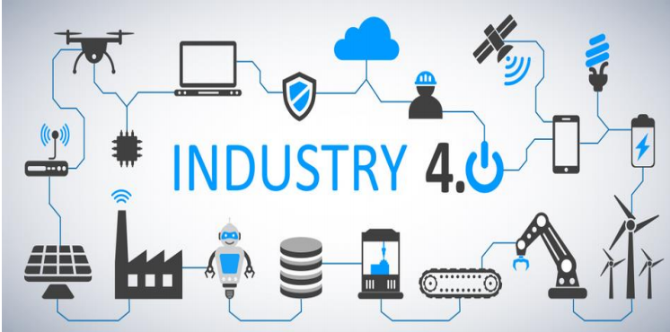
Industrial Revolution (IR 4.0)

Slide 18
Role of Data for Emerging Technologies
Data is regarded as the new oil and strategic asset since we are living in the age of big data, and drives or even determines the future of science, technology, the economy, and possibly everything in our world today and tomorrow.
Data have not only triggered tremendous hype and buzz but more importantly, presents enormous challenges that in turn bring incredible innovation and economic opportunities.
This reshaping and paradigm-shifting are driven not just by data itself but all other aspects that could be created, transformed, and/or adjusted by understanding, exploring, and utilizing data.
The preceding trend and its potential have triggered new debate about data-intensive scientific discovery as an emerging technology, the so-called “fourth industrial revolution,”

Slide 19
Role of Data for Emerging Technologies
There is no doubt, nevertheless, that the potential of data science and analytics to enable data-driven theory, economy, and professional development is increasingly being recognized.
This involves not only core disciplines such as computing, informatics, and statistics, but also the broad-based fields of business, social science, and health/medical science.

Slide 20
Enabling devices and network (Programmable devices)
In the world of digital electronic systems, there are four basic kinds of devices: memory, microprocessors, logic, and networks.
Memory devices store random information such as the contents of a spreadsheet or database.
Microprocessors execute software instructions to perform a wide variety of tasks such as running a word processing program or video game.
Logic devices provide specific functions, including device-to-device interfacing, data communication, signal processing, data display, timing and control operations, and almost every other function a system must perform.
The network is a collection of computers, servers, mainframes, network devices, peripherals, or other devices connected to one another to allow the sharing of data.
An excellent example of a network is the Internet, which
connects millions of people all over the world

Slide 21
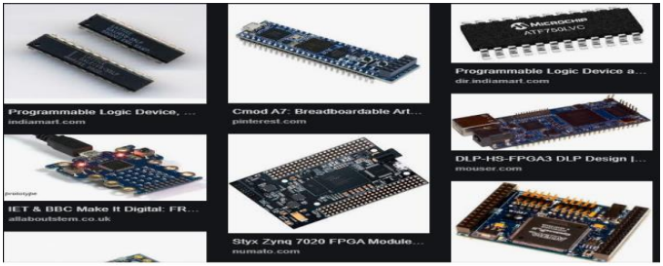
Enabling devices and network (Programmable devices)
Programmable devices usually refer to chips that incorporate field programmable logic devices (FPGAs), complex programmable logic devices (CPLD) and programmable logic devices (PLD).
There are also devices that are the analog equivalent of these called field-programmable analog arrays.

Slide 22
Enabling devices and network (Programmable devices)
Why is a computer referred to as a programmable device?
Because what makes a computer a computer is that it follows a set of instructions.
Many electronic devices are computers that perform only one operation, but they are still following instructions that reside permanently in the unit.

Slide 23
List of some Programmable devices
Achronix Speedster SPD60
Actel’s
Altera Stratix IV GT and Arria II GX
Atmel’s AT91CAP7L
Cypress Semiconductor’s programmable system-on-chip (PSoC) family
Lattice Semiconductor’s ECP3
Lime Microsystems’ LMS6002
Silicon Blue Technologies
Xilinx Virtex 6 and Spartan 6
Xmos Semiconductor L series

Slide 24
List of some Programmable devices
A full range of network-related equipment referred to as Service Enabling Devices (SEDs), which can include:
Traditional channel service unit (CSU) and data service unit (DSU)
Modems
Routers
Switches
Conferencing equipment
Network appliances (NIDs and SIDs)
Hosting equipment and servers

Slide 25
Human to Machine Interaction
Human-machine interaction (HMI) refers to the communication and interaction between a human and a machine via a user interface.
Nowadays, natural user interfaces such as gestures have gained increasing attention as they allow humans to control machines through natural and intuitive behaviors
What is interaction in human-computer interaction?
HCI (human-computer interaction) is the study of how people interact with computers and to what extent computers are or are not developed for successful interaction with human beings.
As its name implies, HCI consists of three parts: the user, the computer itself, and the ways they work together.

Slide 26
Human to Machine Interaction
How do users interact with computers?
The user interacts directly with hardware for the human input and output such as displays, e.g. through a graphical user interface.
The user interacts with the computer over this software interface using the given input and output (I/O) hardware.
How important is human-computer interaction?
The goal of HCI is to improve the interaction between users and computers by making computers more user-friendly and receptive to the user's needs.
The main advantages of HCI are simplicity, ease of deployment & operations and cost savings for smaller set-ups.
They also reduce solution design time and integration complexity.

Slide 27
Disciplines Contributing to (HCI)
Cognitive psychology: Limitations, information processing, performance prediction, cooperative working, and capabilities.
Computer science: Including graphics, technology, prototyping tools, user interface management systems.
Linguistics.
Engineering and design.
Artificial intelligence.
Human factors.

Slide 28
Future Trends in Emerging Technologies
Emerging technology trends in 2019
5G Networks
Artificial Intelligence (AI)
Autonomous Devices
Blockchain
Augmented Analytics
Digital Twins
Enhanced Edge Computing and
Immersive Experiences in Smart Spaces

Slide 29
Some emerging technologies that will shape the future of you and your business
The future is now or so they say. So-called emerging technologies are taking over our minds more and more each day.
These are very high-level emerging technologies though.
They sound like tools that will only affect the top tier of technology companies who employ the world’s top 1% of geniuses.
This is totally wrong. Chatbots, virtual/augmented reality, blockchain, Ephemeral Apps and Artificial Intelligence are already shaping your life whether you like it or not.
At the end of the day, you can either adapt or die.

Slide 30
End of Chapter 1

Slide 31
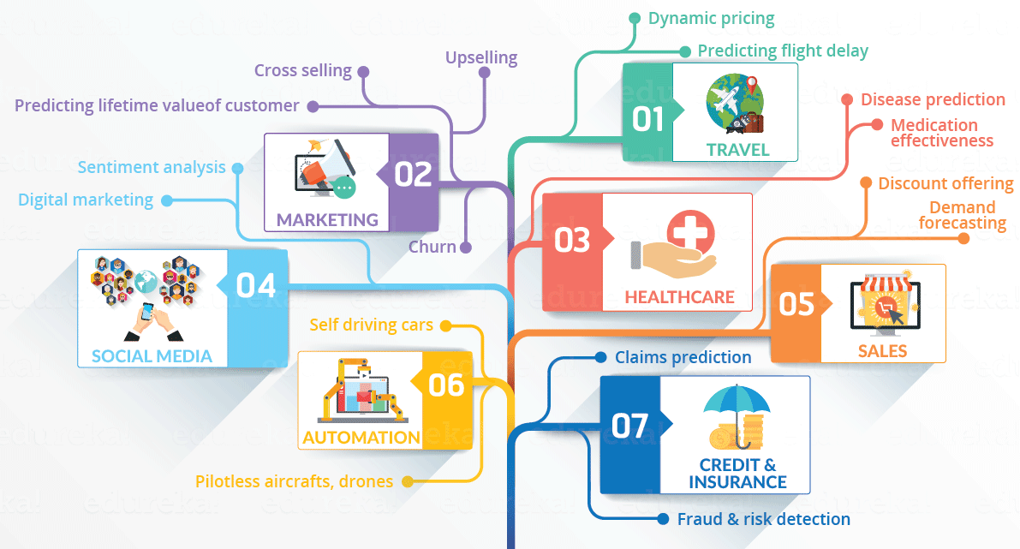
Chapter 2: Data Science

Slide 32
Chapter Objective
At the end of this chapter student should be able to :
Describe what data science is and the role of data scientists.
Differentiate data and information.
Describe data processing life cycle .
Understand different data types from diverse perspectives.
Describe data value chain in emerging era of big data.
Understand the basics of Big Data.
Describe the purpose of the Hadoop ecosystem components.

Slide 33
Chapter Outline
Overview of data science
Data Processing Cycle
Data types and their representation
Data value Chain
Basic concepts of big data

Slide 34
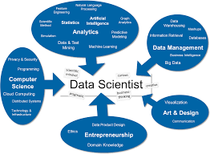
Overview Data science
What is data science?
It is a multi-disciplinary field that uses scientific methods, processes, algorithms, and systems to extract knowledge and insights from structured, semi-structured and unstructured data.
Data science is much more than simply analyzing data.
It is used to create data-centric artifacts and applications that address specific scientific, socio-political, business, or other issues.
It offers a range of roles and requires a range of skills.
Mathematics
Statistics
Data engineering
Visualization
Advanced computing

Slide 35
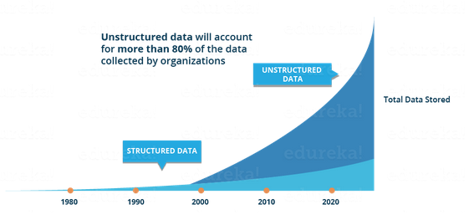
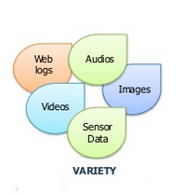
Why Data science?
Data are available in various form ( structure & unstructured ) and these days generated in bulk from different source , essentially free and ubiquitous data.
The granularity, size and accessibility data, comprising both physical, social, commercial and political spheres has exploded in the last decade or more.
Simple tools are not capable of processing this huge volume and variety of data.
The ability to take data—to be able to understand it, to process it, to extract value from it, to visualize it, to communicate it—that’s going to be a hugely important skill, not only at the professional level but even at the educational level for elementary school kids, for high school kids, for college kids.
That is Why???

Slide 36
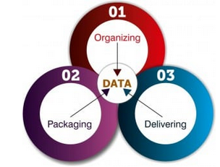
Data Science: Core Components
Three components of Data Science:
Data science consists of three components, that is, organizing, packaging and delivering data (OPD of data).
1. Organizing the data: Organizing is where the planning and execution of the physical storage and structure of the data takes place after applying the best practices in data handling.
2. Packaging the data: Packaging is where the prototypes are created, the statistics is applied and the visualisation is developed. It involves logically as well as aesthetically modifying and combining the data in a presentable form.
3. Delivering the data: Delivering is where the story is narrated and the value is received. It makes sure that the final outcome has been delivered to the concerned people.

Slide 37
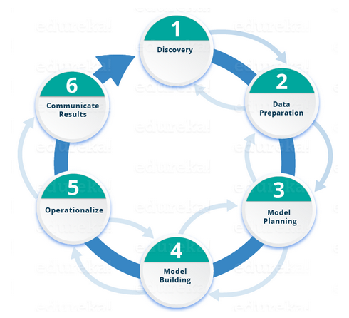
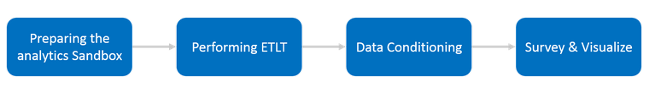
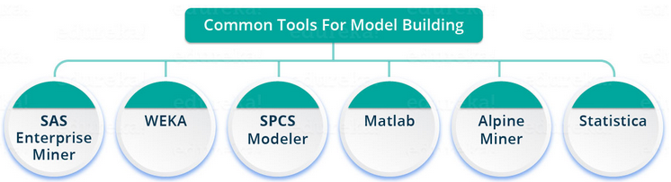
Lifecycle of Data Science
Phase 1: understand the various specifications, requirements, priorities and required budget. Ask the right questions : about the required resources present in terms of people, technology, time and data to support the project. need to frame the business problem and formulate initial hypotheses (IH) to test.
Phase 6 : evaluate whether the goal that has planned in the first phase is achieved. identify all the key findings, communicate to the stakeholders and determine if the results of the project are a success or a failure based on the criteria developed in Phase 1.
Phase 2: you require analytical sandbox in which you can perform analytics for the entire duration of the project. You need to explore, preprocess and condition data prior to modeling. You will perform ETLT (extract, transform, load and transform) to get data into the sandbox.
Phase 5: deliver final reports, briefings, code and technical documents. a pilot project is also implemented in a real-time production environment. This will provide you a clear picture of the performance and other related constraints on a small scale before full deployment.
Phase 3 determine the methods and techniques to draw the relationships between variables. These relationships will set the base for the algorithms which you will implement in the next phase.
apply Exploratory Data Analytics (EDA) using various statistical formulas and visualization tools.
Phase 4: develop datasets for training and testing purposes. Decide whether your existing tools will suffice for running the models or it will need a more robust environment (like fast and parallel processing). analyze various learning techniques like classification, association and clustering to build the model.

Slide 38
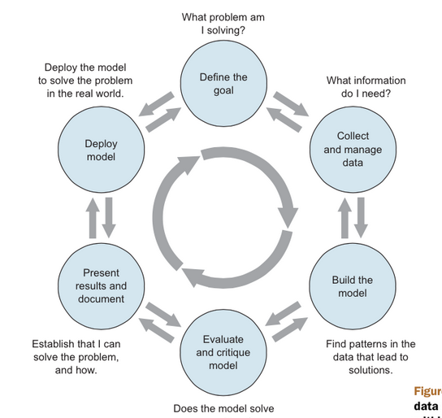
Data science Work flow
What is the question/problem?
Who wants to answer/solve it?
What do they know/do now?
How well can we expect to answer/solve it?
How well do they want
What data is available?
Is it good enough?
Is it enough?
What are sensible measurements to derive from this data? Units, transformations, rates, ratios, etc.
Where will it be hosted?
Who will use it?
Who will maintain it?
What kind of problem is it? E.g., classification, clustering, regression, etc.
What kind of model should I use?
Do I have enough data for it?
Does it really answer the question?
Again, what are the measurements that tell the real story?
How can I describe and visualize them effectively?
Did it work? How well?
Can I interpret the model?
What have I learned?

Slide 39
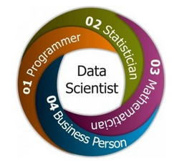
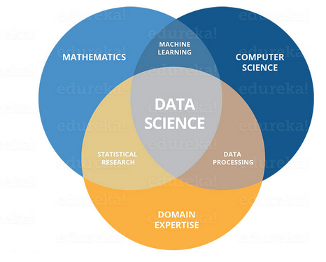
Who is Data Scientists ??
A Data Scientists in simple words is one who practices the art of Data Science
Data scientists are those who crack complex data problems with their strong expertise in certain scientific disciplines.
They work with several elements related to mathematics, statistics, computer science, and their domain (though they may not be an expert in all these fields).
Data Scientist should be very strong in any of these skills

Slide 40
Data & Information
What is data?
Data can be defined as a representation of facts, concepts, or instructions in a formalized manner, which should be suitable for communication, interpretation, or processing, by human or electronic machines.
It is unprocessed facts and figures represented with the help of characters such as alphabets (A-Z, a-z), digits (0-9) or special characters (+, -, /, *, , =, etc.) and picture ,sound and video.
Information is the processed data on which decisions and actions are based
Data Information
PROCESSING

Slide 41
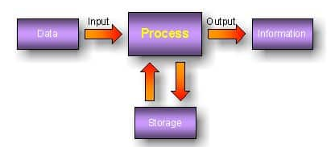
Data Processing Cycle
The collection and manipulation of items of data to produce meaningful information
Data processing is the re-structuring or re-ordering data to increase its usability
Data processing cycle is a sequence of steps or operations for processing data to make it usable format
Collection of row data needs to be fed in the cycle for processing.
The first step and called input
Outcome.
Processed & meaning full data
the data is useful and provides information.
Manual , electronic data processing, mechanical processing or automated means

Slide 42
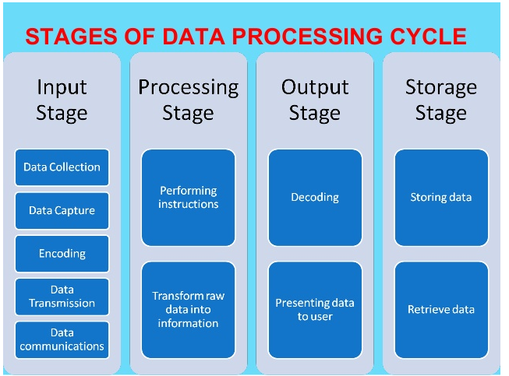
Data Processing Cycle

Slide 43
Data types and their representation
Data can be available in different format and can be described from different perspectives.
Data type is simply an attribute of data that tells the compiler or interpreter how the programmer intends to use the data.
Metadata (Data about Data) is a data that provide additional information about a specific set of data.
It is not a separate data structure.
Data types can be categorized from programming perspective as follows:
Integers(int)- is used to store whole numbers, mathematically known as integers
Booleans(bool)- is used to represent restricted to one of two values: true or false
Characters(char)- is used to store a single character
Floating-point numbers(float)- is used to store real numbers
Alphanumeric strings(string)- used to store a combination of characters and numbers

Slide 44
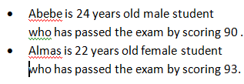
Continue …..
There are three categories of data types from analytics perspective.
Structured data − Relational data.
Semi Structured data − XML data.
Unstructured data − Word, PDF, Text, Media L
.
Name | Sex | Age | Result | Status
Abebe | M | 24 | 90 | Pass
Almaz | F | 22 | 93 | Pass
<student><name> Abebe</name> <sex>Male</sex> <age>24</age> <Result>90</Result> <Status>Pass</Status></student> | <student><name> Abebe</name> <sex>Male</sex> <age>24</age> <Result>90</Result> <Status>Pass</Status></student

Slide 45
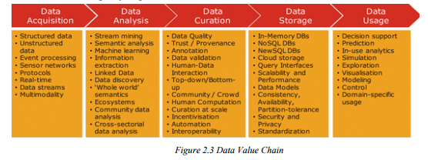
Data value Chain
Data Value Chain is a series of activities that introduce information flow within a big data system needed to generate value and useful insights from data.
The Big Data Value Chain identifies the following key high-level activities:

Slide 46
Data value Chain
Due to the advent of new technologies, devices, and communication means like social networking sites, IoT and soon the amount of data produced by mankind is growing rapidly every year.
.
The amount of data produced by us
If this data is stored inside disks and pile up them, it may fill an entire football field

Slide 47
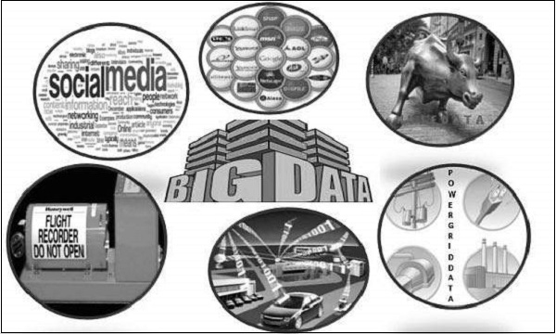
Basic concepts of big data
What Is Big Data?
Big data is a large and complex collection of data sets that is difficult to process using on-hand database management tools or traditional data processing applications.
Sources of Big data.
Stock Exchange ck Data
Black Box Data

Slide 48
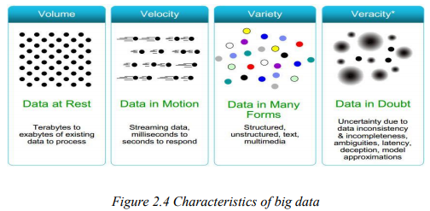
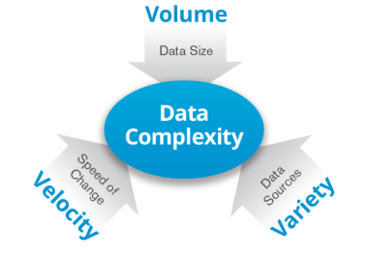
Characteristics of big data
Very difficult to process and store it in the traditional method of data storage and processing with one computer.
It is also characterized by 3V and more
Volume: large amounts of data Zeta bytes/Massive datasets
Velocity: Data is live streaming or in motion
Variety: data comes in many different forms from diverse sources
Veracity: can
It use cluster computing and distributed storage
Storage and processing is done on multiple computers

Slide 49
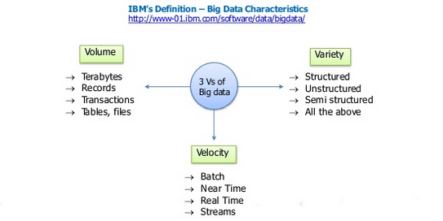
Characteristics of big data

Slide 50
Benefits of Big Data
Resource Pooling: Combining the available storage space in different machine to hold data is a clear benefit, but CPU and memory pooling are also extremely important. Processing large datasets requires large amounts of all three of these resources.
High Availability: Clusters can provide varying levels of fault tolerance and availability guarantees to prevent hardware or software failures from affecting access to data and processing. This becomes increasingly important as we continue to emphasize the importance of real-time analytics. 30 •
Easy :Scalability Clusters make it easy to scale horizontally by adding additional machines to the group. This means the system can react to changes in resource requirements without expanding the physical resources on a machine.

Slide 51
Big Data Technologies
Big data technologies are important in providing
Helps to analyze huge data which are available in various form and stored in distributed machines.
It gives more accurate analysis that will lead to more concrete decision-making resulting.
It has greater operational efficiencies,
It reduced storage and processing cost
It reduced risks for the business by using distributed computing and storage.
Doest require powerful and special machine for data processing and storage
It only require an infrastructure that can manage and process huge volumes different data type
structured and
unstructured data in real time and
can protect data privacy and security.
There are various technologies in the market from different vendors including Amazon, IBM, Microsoft, etc., to handle big data.

Slide 52
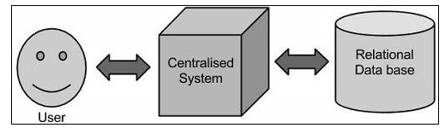
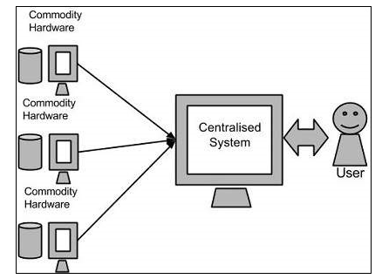
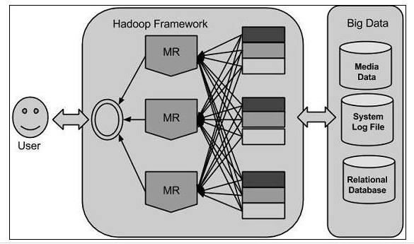
Storage & processing
Traditional Approach | Google’s Solution | Hadoop
One computer to store and process Select DBMS tool Oracle, SQL… Use interact with the app Works on less volume Single point of failure Not scalable | Parallel storage & Processing Use MapReduce divide task into small part Assign each part to d/t PC Collect result from each PC & integrate | Parallel storage & Processing Use MapReduce divide task into small part Assign each part to more PC Collect result from each PC & integrate

Slide 53
Data Science Tools For Data Storage
Apache Hadoop
Apache Hadoop is a free, open-source framework that can manage and store tons and tons of data. It provides distributed computing of massive data sets over a cluster of 1000s of computers. It is used for high-level computations
Here’s a list of features of Apache Hadoop:
Effectively scale large data on thousands of Hadoop clusters
It uses the Hadoop Distributed File System (HDFS) for data storage which distributes massive amounts of data across several nodes for distributed, parallel computing
Provides the functionality of other data processing modules, such as Hadoop MapReduce, Hadoop YARN, and s
and data processing.

Slide 54
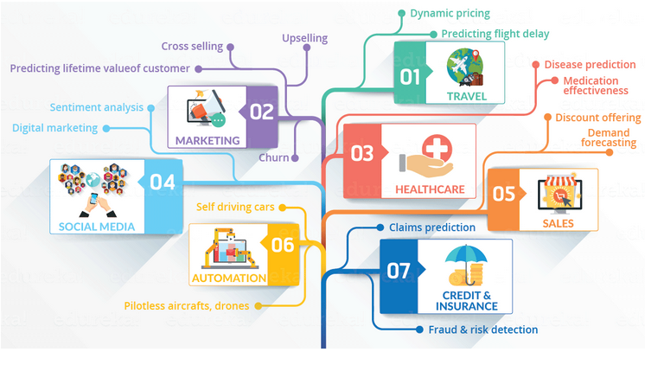
Data Science Applications
Fraud and Risk Detection
Healthcare
Internet Search
Targeted Advertising
Website Recommendations
Advanced Image Recognition
Speech Recognition
Airline Route Planning
Gaming
Augmented Reality

Slide 55
End of Chapter 2

Slide 56
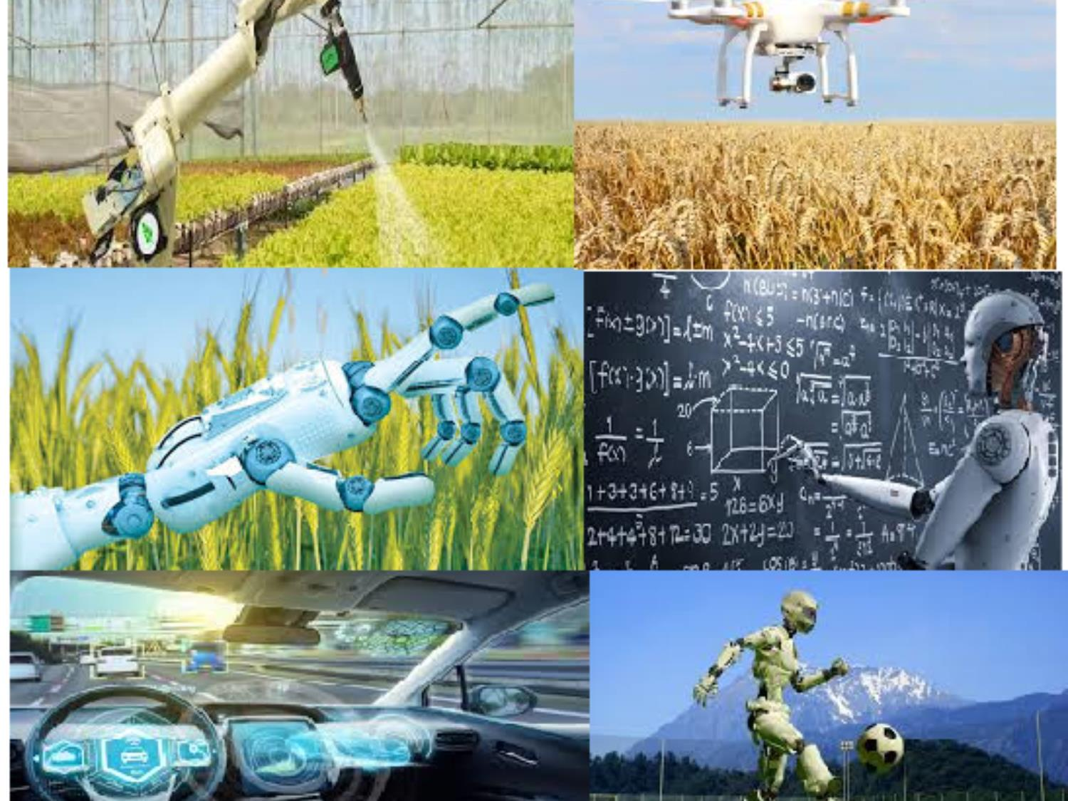
Chapter 3: Artificial Intelligence (AI)

Slide 57
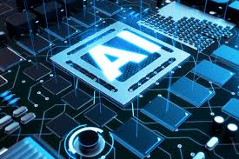
Chapter Outline
Introduction to AI
What is AI
History of AI
Levels of AI
Types of AI
Applications of AI
Agriculture
Health
Business (Emerging market)
Education
AI tools and platforms (eg: scratch/object tracking)
Sample application with hands on activity (simulation based)
Ever to Excel!

Slide 58
What is Artificial Intelligence?
Artificial Intelligence (afterwards call it as AI) is composed two words: Artificial and Intelligence.
AI=Artificial + Intelligence
Artificial defines as “man-made” and Intelligence defines the “thinking power” or “the ability to learn and solve problems” .
There fore, AI means "a man-made thinking power."
So AI defined as: "It is a branch of Computer Science by which we can create intelligent machines which can behave like a human, think like humans, and able to make decisions.”

Slide 59
Intelligence is composed of :
Reasoning
Learning
Problem Solving
Perception
Linguistic Intelligence
AI system composed of agent and its environments.
An agent is anything that can:
Perceive its environment through sensors.
Acts upon that environment through effectors.

Slide 60
Cont..
Intelligent agents must be able to set goals and achieve them.
Machine perception is the ability to use input from sensors (such as cameras, microphones, sensors, etc.) to deduce aspects of the world. e.g., Computer Vision.

Slide 61
High-profile examples of AI includes:
Autonomous vehicles (such as drones and self-driving cars)
Medical diagnosis.
Creating art (such as poetry).
Proving mathematical theorems.
Playing games (such as Chess or Go).
Search engines (such as Google search).

Slide 62
Cont..
Online assistants (such as Siri, Google Assistance, Alexa, Cortana etc. ).
Image recognition in photographs.
Spam filtering.
Prediction of judicial decisions.
Targeting online advertisements

Slide 63
Class Exercise : Getting Aid from Google Assistant
Open Google Assistant from your smart phone
Next speak the following terms and investigate the result from the Google Assistant
Call 994
Call 0839999565645
Open camera
Open telegram
Open Facebook

Slide 64
Needs of AI
AI needed to:
Create expert systems.
Helping machines to find solutions for complex problems.
Goal of AI
The main goals of AI are:
Replicate human intelligence
Solve Knowledge-intensive tasks
An intelligent connection of perception and action

Slide 65
Cont..
Building a machine which can perform tasks that requires human intelligence.
Creating system which can exhibit intelligent behavior, learn new things by itself, demonstrate, explain, and can advise to its user.

Slide 66
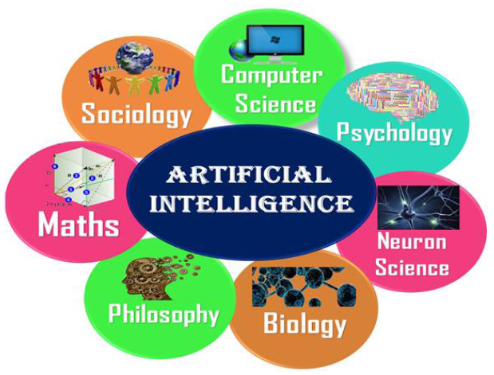
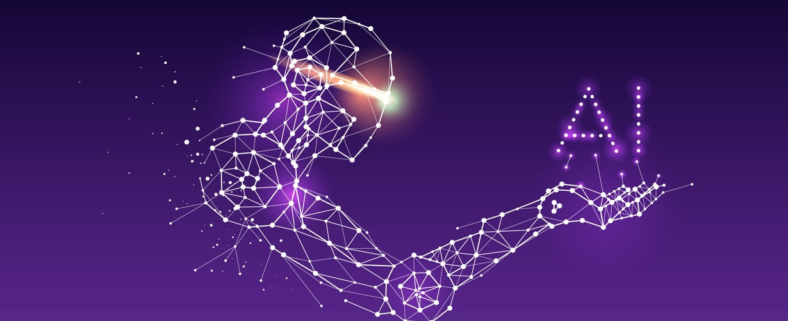
What Comprises to AI?
AI requires the following disciplines :
Mathematics
Biology
Psychology
Sociology
Computer Science
Neurons Study
Statistics

Slide 67
Advantage Vs. Disadvantage of AI
Advantage of AI are:
High accuracy with fewer errors.
High speed.
High reliability.
Useful for risky areas.
Digital Assistant.
Useful as a public utility.

Slide 68
Disadvantages of AI:
High cost.
Can’t think out of the box.
No feeling and emotions.
Increase dependence on machines.
No original creativity.

Slide 70
Assignment
Read about History of AI from page 41-44 of your module and other AI related materials.
Summarize it and prepare a PowerPoint not less than 10 and not more than 12 slides.
Present it to your classmates.

Slide 71
Levels of AI
Seven levels of AI:
Stage 1 – Rule-Based Systems.
Stage 2– Context Awareness and Retention.
Stage 3 – Domain-Specific Expertise.
Stage 4 – Reasoning Machines.
Stage 5 – Self Aware Systems / Artificial General Intelligence (AGI).
Stage 6 – Artificial Super Intelligence (ASI).
Stage 7 – Singularity and Transcendence.

Slide 72
Stage 1 – Rule-Based Systems
The most common uses of AI today fit in this bracket.
Covering everything from business software (Robotic Process Automation) and
Domestic appliances to aircraft autopilots.

Slide 73
Stage 2– Context Awareness and Retention
Algorithms that develop information about the specific domain they are being applied in.
They are trained on the knowledge and experience of the best humans.
Their knowledge base can be updated as new situations and queries arise.
Example:
Chatbots and “Roboadvisors”.

Slide 74
Stage 3 – Domain-Specific Expertise
Going beyond the capability of humans
These systems build up expertise in a specific context taking in massive volumes of information which they can use for decision making.
Example:
Cancer diagnosis, Google Deepmind’s AlphaGo

Slide 75
Stage 4 – Reasoning Machines
These algorithms have some ability to attribute mental states to themselves and others
They have a sense of beliefs, intentions, knowledge, and how their own logic works.
They could reason or negotiate with humans and other machines.
At the moment these algorithms are still in development, however, commercial applications are expected within the next few years.

Slide 76
Stage 5 – Self Aware Systems
These systems have human-like intelligence
The most commonly portrayed AI in media
It is the goal of many working in AI and some believe it could be realized already from 2024.

Slide 77
Stage 6: Artificial Super Intelligence (ASI)
AI algorithms can outsmart even the most intelligent humans in every domain.
Logically it is difficult for humans to articulate what the capabilities might be,
yet we would hope examples would include solving problems we have failed to so far, such as world hunger and dangerous environmental change.

Slide 78
Stage 7 – Singularity and Transcendence
This is the idea that development provided by ASI (Stage 6) leads to a massive expansion in human capability.
Human augmentation could connect our brains to each other and to a future successor of the current internet, creating a “hive mind” that shares ideas, solves problems collectively, and even gives others access to our dreams as observers or participants. Pushing this idea further, we might go beyond the limits of the human body and connect to other forms of intelligence on the planet

Slide 79
Stage 7 – Singularity and Transcendence
Animals, plants, weather systems, and the natural environment. Some proponents of singularity such as Ray Kurzweil, Google’s Director of Engineering, suggest we could see it happen by 2045 as a result of exponential rates of progress across a range of science and technology disciplines. The other side of the fence argues that singularity is impossible and human consciousness could never be digitized.

Slide 80
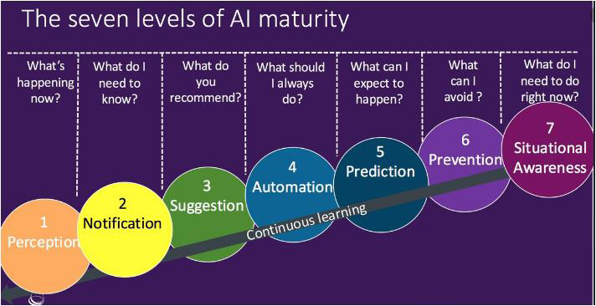

Slide 81
Type of AI
AI mainly divide based of capabilities and functions
Based on Capabilities AI classified as:
Narrow(Weak) AI
General AI
Super (Strong) AI

Slide 82
Type of AI
Based on Function AI classified as:
Reactive Machines
Limited Memory
Theory of Mind
Self-Awareness

Slide 83
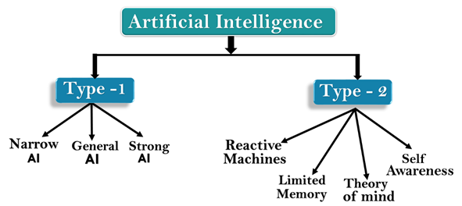
Type of AI

Slide 84
How Human Thinks?
The goal of many researchers is to create strong and general AI.
These types of AI learns like a human and can solve general problems as the human brain does.
To achieve this it requires many years.
Intelligence or the cognitive process of human is composed of three main stages:
Observe and input the information or data in the brain.
Interpret and evaluate the input.
Make decisions

Slide 85
Mapping human thinking to AI components
AI is the science of simulating human thinking.
Because of this it is possible to map human thinking to AI components.
Human Thinking
AI System
Acquire information
Sensing layer
Interpreting and evaluating the input data.
Interpretation layer
Make decision
Interacting layer

Slide 86
Influencers of AI
AI is influenced by :
Big data: Structured data versus unstructured data
Advancements in computer processing speed and new chip architectures
Cloud computing and APIs
The emergence of data science

Slide 87
Applications of AI
AI can solve complex problems in an efficient way in multiple industries
some sectors which have the application of Artificial Intelligence
AI in agriculture
AI in Healthcare
AI in education:
AI in Finance and E-commerce
AI in Gaming
AI in Social Media
AI in Data Security
AI in Travel &Transport
AI in the Automotive Industry
AI in Robotics:
AI in Entertainment

Slide 88
AI tools and platforms
AI platforms are defined as some sort of hardware architecture or software framework , that allows the software to run.
Artificial intelligence (AI) platforms provide users a tool kit to build intelligent applications
Some platforms offer pre-built algorithms and simplistic workflows, others require a greater knowledge of development and coding

Slide 89
Functionalities of AI Algorithms
Some functionality of the algorithms are:
Image Processing
Natural language processing (information retrieval, text mining, question answering, machine translation …etc)
Voice recognition
Recommendation system
Predictive analytics

Slide 90
AI tools:
✓ Search and optimization
✓ Logic
✓ Probabilistic methods for uncertain reasoning
✓ Classifiers and statistical learning methods
✓ Neural networks
✓ Control theory
✓ Languages

Slide 91
Simple AI application
1.Commuting
➢ Google’s AI-Powered Predictions
➢ Ridesharing Apps Like Uber and Lyft
➢ Commercial Flights Use an AI Autopilot
2.Email
➢ Spam Filters
➢ Smart Email Categorization
3.Social Networking
4.Online Shopping
5.Mobile Use
➢ Voice-to-Text
➢ Smart Personal Assistants(Siri and Google Now)
➢ Alexa, an AI-powered personal assistant that accepts voice commands to create to-do lists, order items online, set reminders, and answer questions

Slide 92
End of Chapter 3

